Slide 1

Skinner Elementary
Campus overall 2017 CaSE Rating: Recognized
BISD is rated overall Recognized for CaSE House Bill 5, Section 46; Texas Education Code Section 39.0545

Slide 2
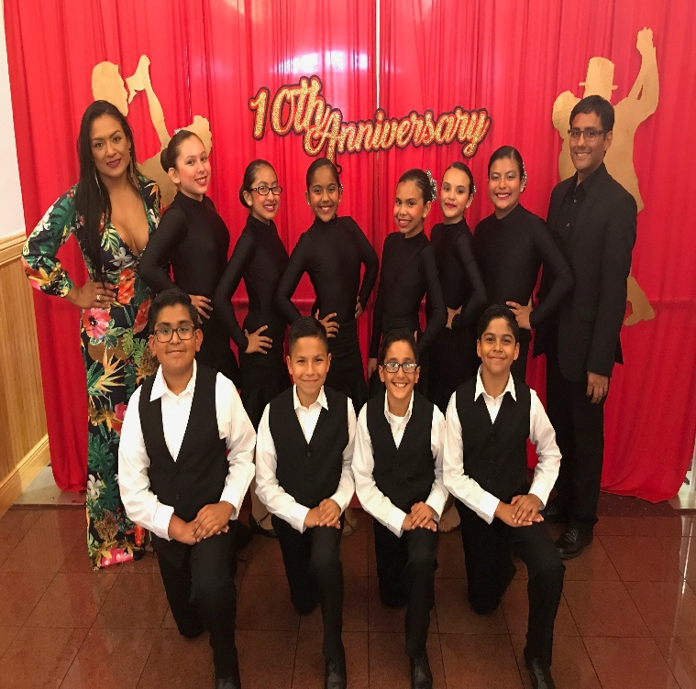
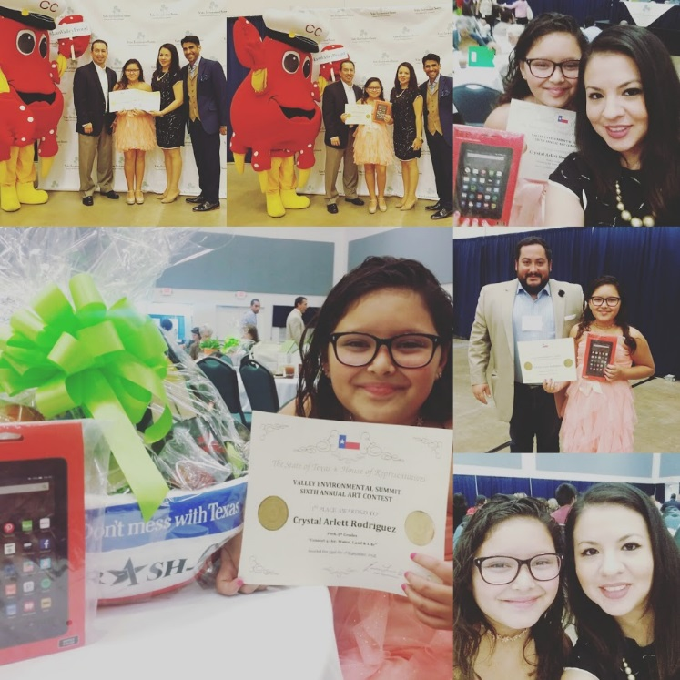
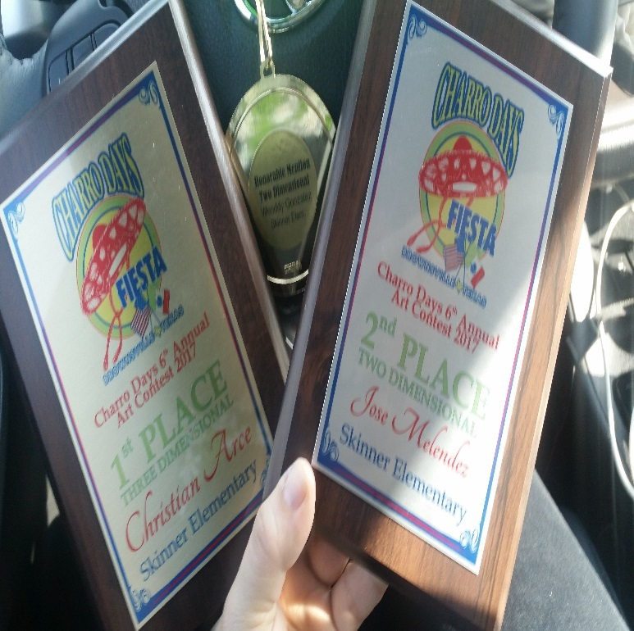
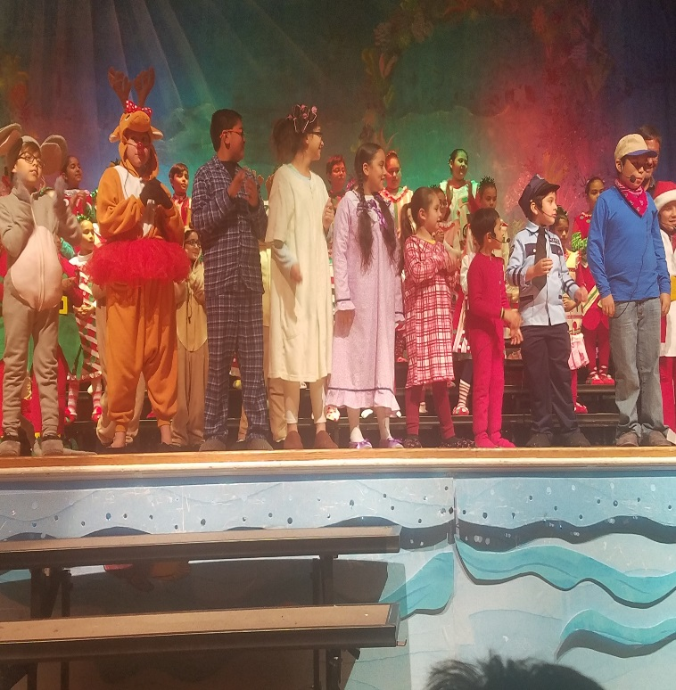
Fine Arts Program rated Recognized
The Fine Arts Department provided students with different experiences such as:
Choir
Art Exhibits
Competitions:
Ballroom Dance
Various Art Contests
Ballroom Dancers
Art Summit Cometition
Charro Day Art
Contest Winners
Christmas Program

Slide 3
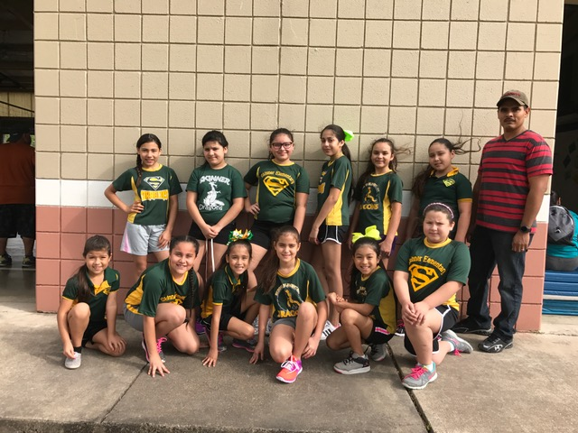
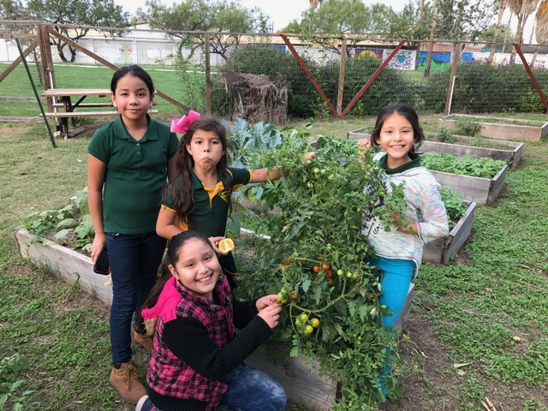
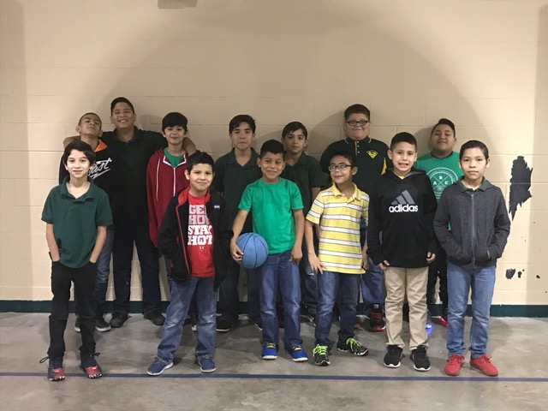
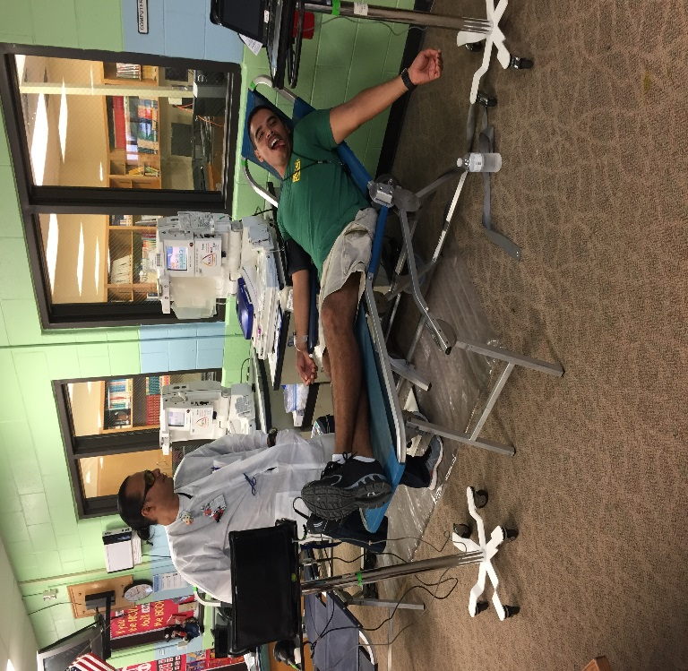
Wellness Program rated Exemplary
description of pictures
The Wellness & Physical Education participated in:
Red Ribbon Week Activities
Catch Program
FitnessGram
Get Moving activities with community/campus
Health Fair
Blood Drive
Girls Volleyball Team
Catch Club- Gardening
Boys Basketball Team
Blood Drive

Slide 4
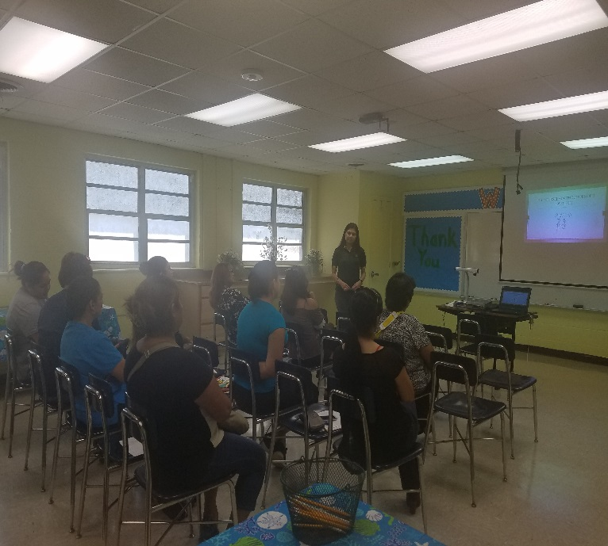
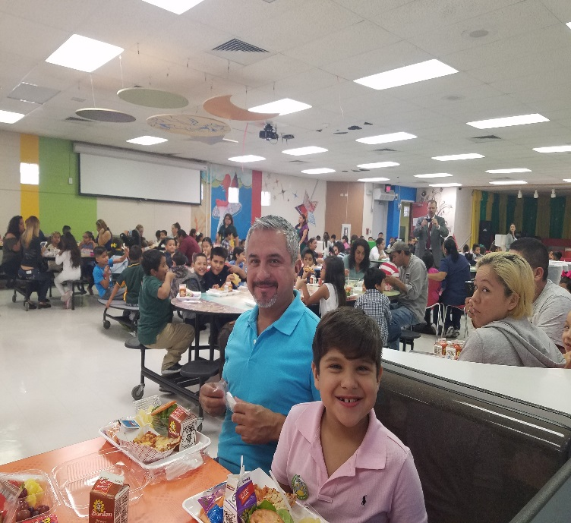
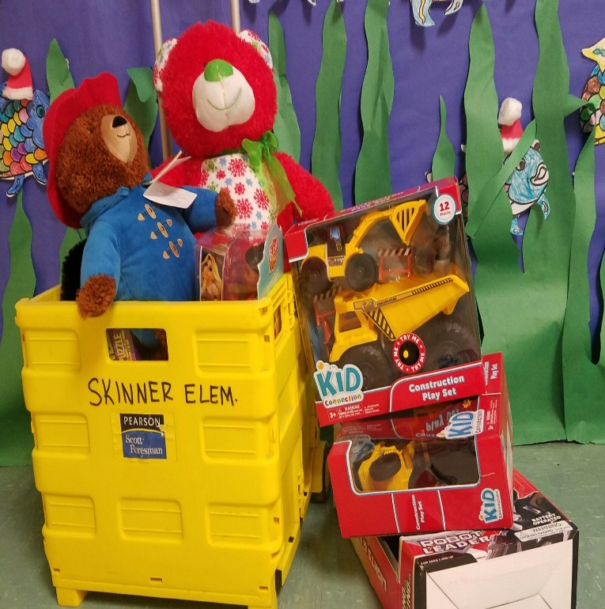
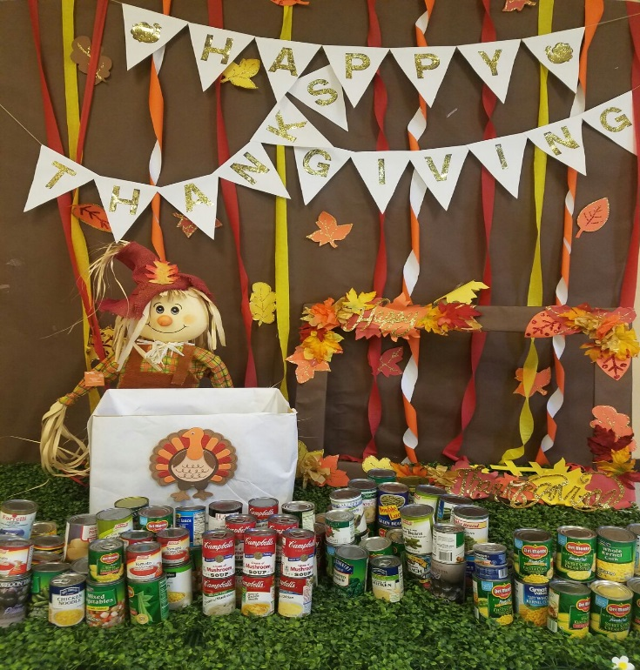
Community and Parental Involvement rated Recognized
description of pictures
Community & Parental Involvement conducted bimonthly parent meetings where activities were provided in different areas such as:
- academics
Strategies for state assessments
Technology
We also conducted:
Food, clothing, school supply drive and toy drives.
Parent Meeting- Dyslexia
Breakfast with parents
Toy Drive
Canned Good Drive

Slide 5
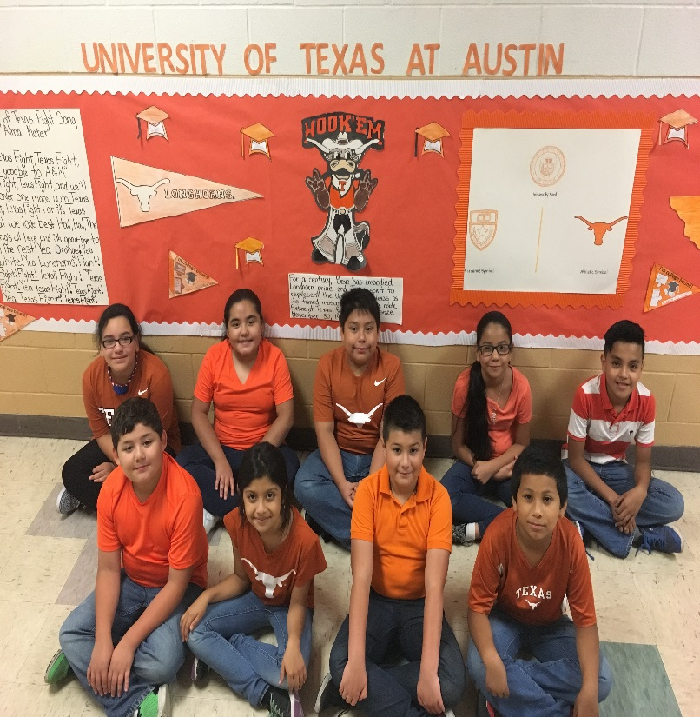
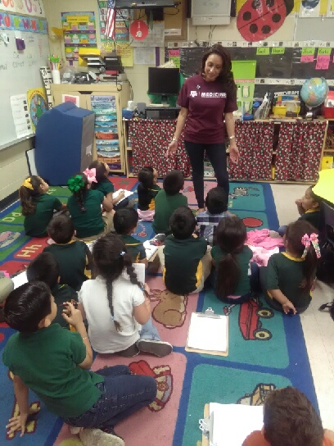
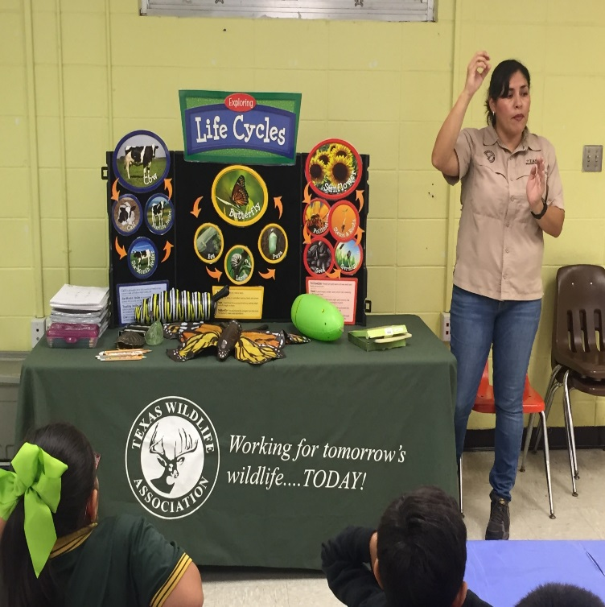
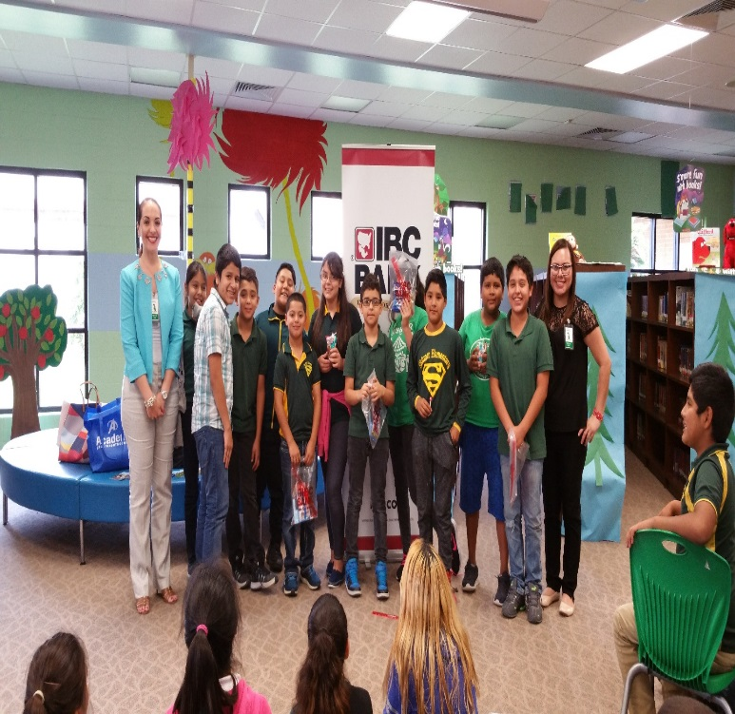
21st Century Workforce Development rated Recognized
description of pictures
College & Career Readiness
Careers:
Boarder Patrol, nurse, engineer, teacher, police officer, banker, lawyer, dentist etc…
Universities:
UTRGV
UT Austin
Baylor
Harvard, Etc…
4th grade UT Austin
Texas A&M Presenter
Texas Wildlife Presenter
IBC Bank Presenters

Slide 6
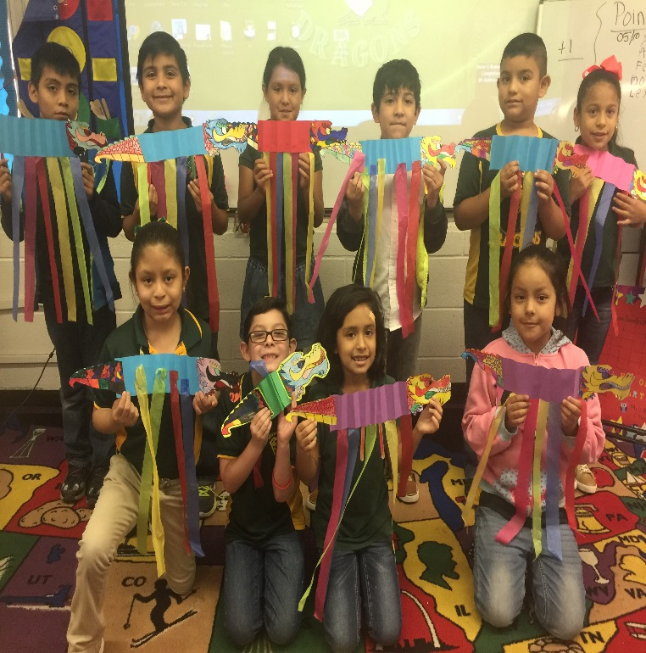
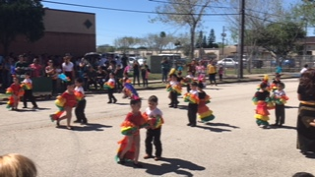
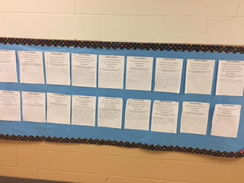
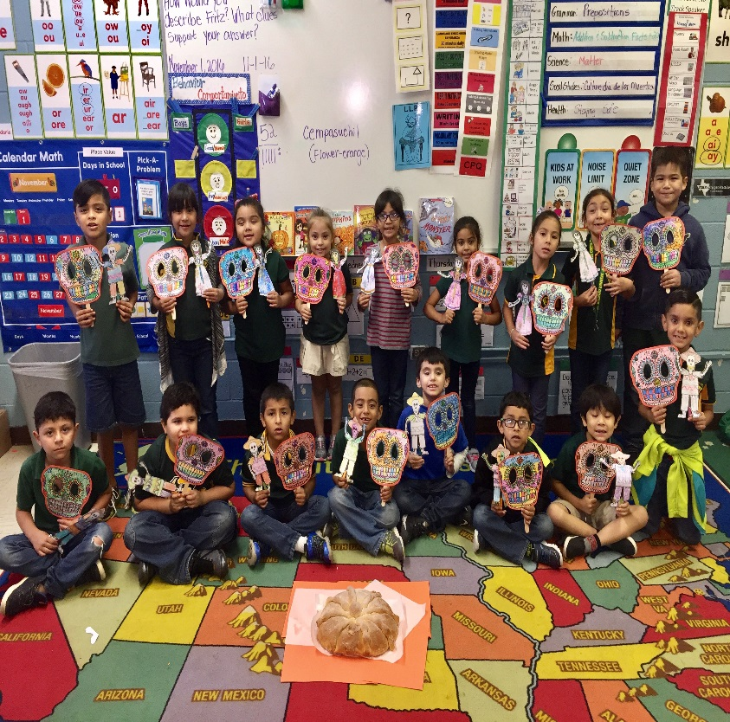
Second Language Acquisition rated Exemplary
description of pictures
Día de los Muertos
Charro Day’s
Cinco de Mayo
Chinese New Year
16 de Septiembre
Black Heritage Month
Chinese New Year
Charro day PK Dance
Black Heritage Writing
Samples
Día de Muertos

Slide 7
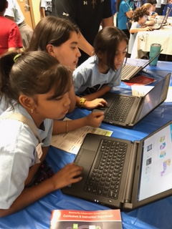
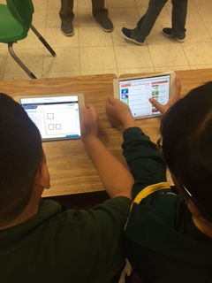
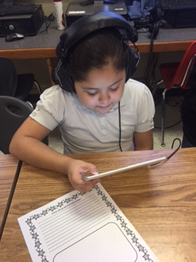
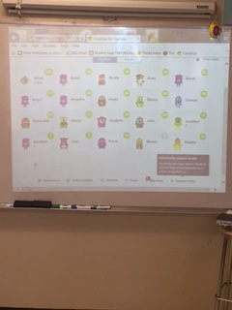
Digital Learning Environment rated Recognized
description of pictures
Technology Projects
-Ipad Integration
iStation
Think Through Math
Clickers
Technology Club
Coding Club
Coding Club
Ipads- TTM
IPADS
Class Dojo

Slide 8
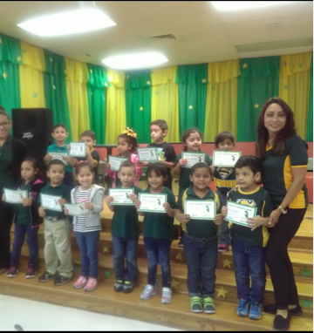
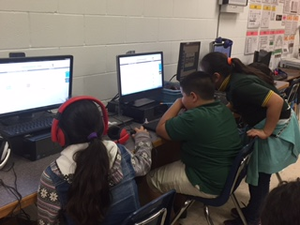
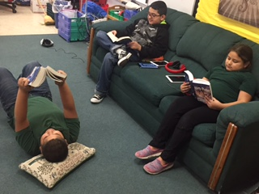
Dropout Preventions Strategies rated Recognized
description of pictures
Brief description of services or campus recognitions in this program area.
Attendance for At-Risk students
TARP Report
At-Risk students participated in afterschool tutorials and Saturday tutorials
Perfect Attendance Awards
Extended day- Activities

Slide 9
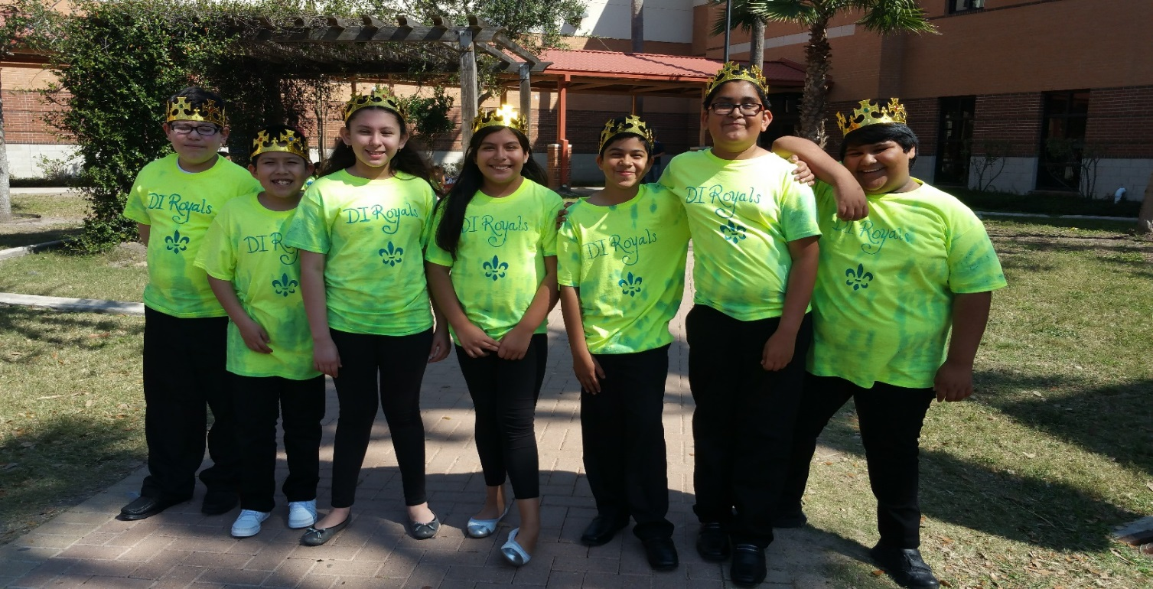
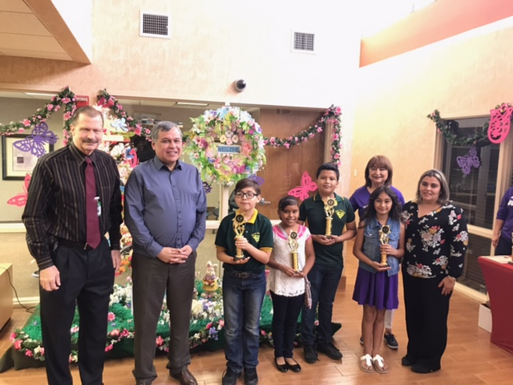
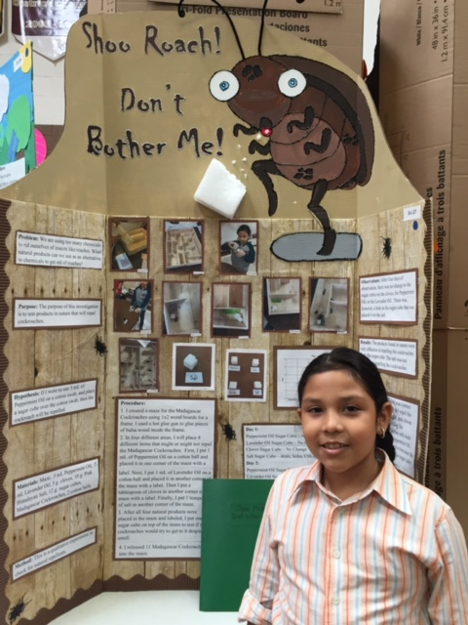
Educational Programs for G/T rated Acceptable
description of pictures
Destination Imagination
Brainsville
UIL
Science Fair
Art Contests
Stock Market
Destination Imagination Team
Stock Market Team
Science Fair

